Slide 1
Scientific calculator
Cs434 project
Kaan yılmaz

Slide 2
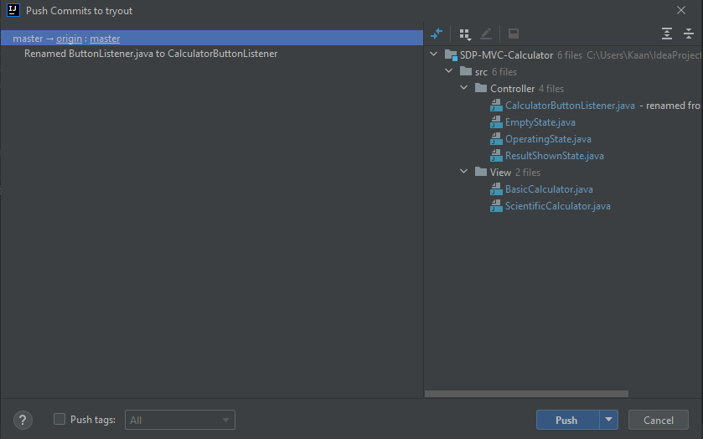
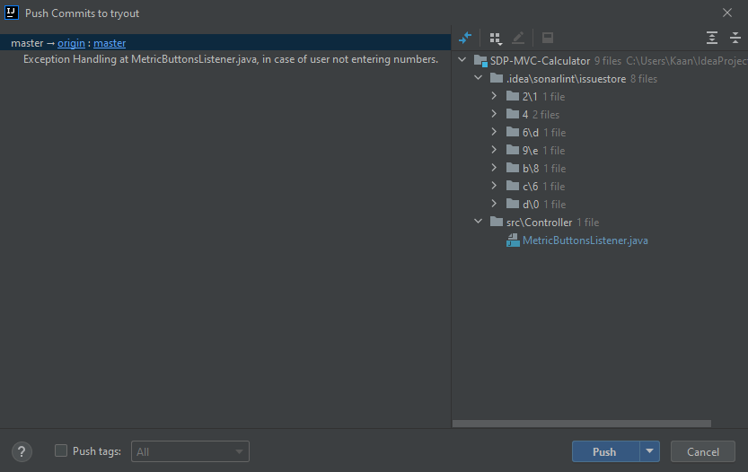
Git was used as a version management tool
Repository is private as for the moment.

Slide 3
PROJECT Archıtecture
Project architecture is MVC.
Simple and most suitable one for my experience.

Slide 4
GUI
Coded with SWING
Created with Singleton Pattern
WHY?
User can only use one window of each calculator type
Eliminates creating multiple windows of same type

Slide 5
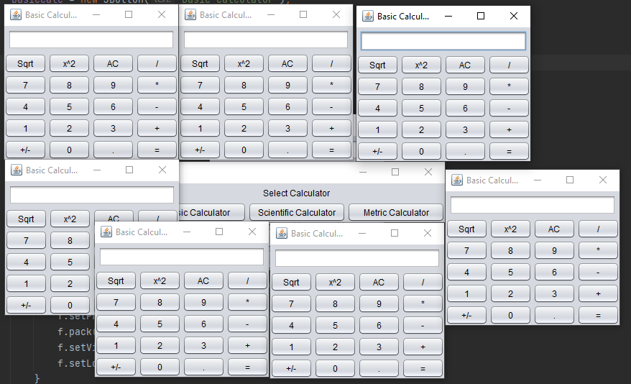

Slide 6
State
WHY?
In the first version there were multiple if-else statements inside if-else statements.

Slide 7
STATE
For ex:
After a result is shown, calculator had to clear the input field.
For that it stored a variable and checked it every time you press a number.
Every time you press a button it checked if it is empty, if it was, it did nothing.
If it wasn’t it performed the task.
This also helped exception handling.

Slide 8
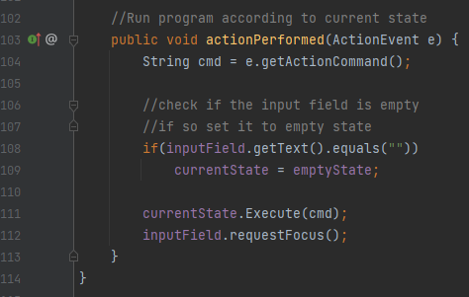

Slide 9
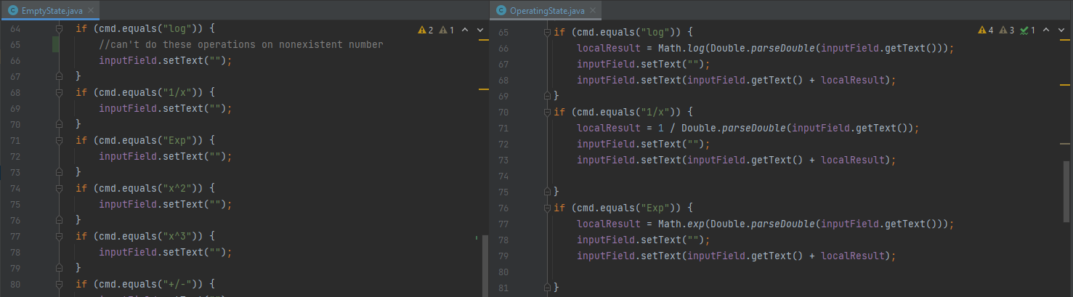

Slide 10
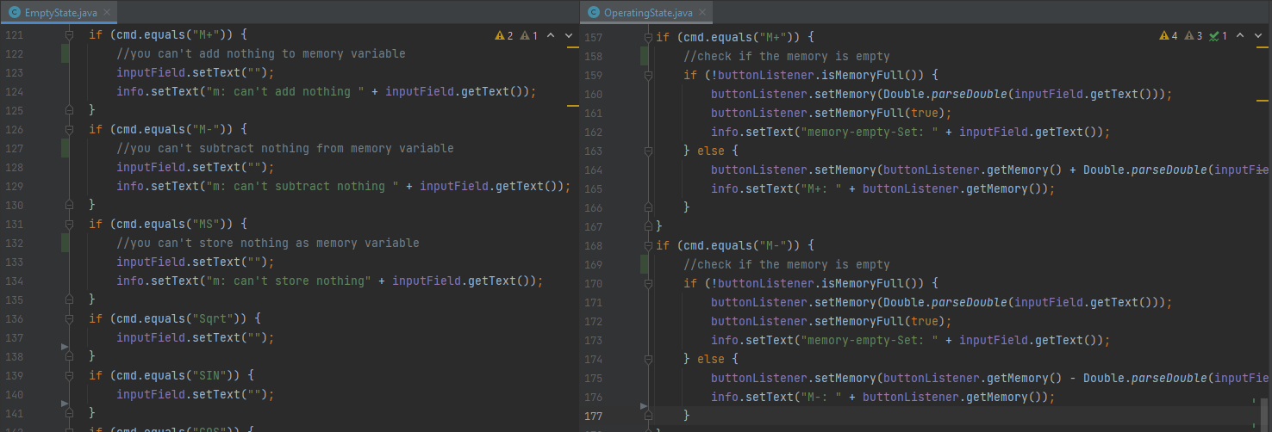

Slide 11
Command and simple factory together
WHY?
I can’t implement every single unit conversion, and I can’t predict what will need to be implemented.
In the future, somebody can easily, without disturbing other pieces of code, add a new unit conversion mechanism to my program.
This instances can be called “command” which convert something.

Slide 12
Command and simple factory together
By using it with command, I can cut the class count in half, logic is:
If a unit can be converted to other unit, other unit can be converted to “the” unit. (Execute-unExecute)
It works like do-undo mechanism.
If you use one of the available classes, you use execute method.
If you use reverse of the operation, you use unexecute method.

Slide 13
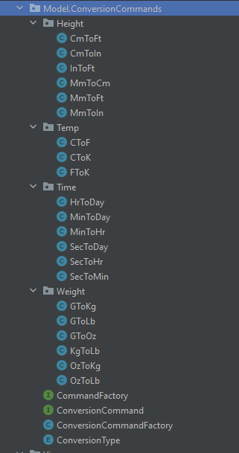
Why command?

Slide 14
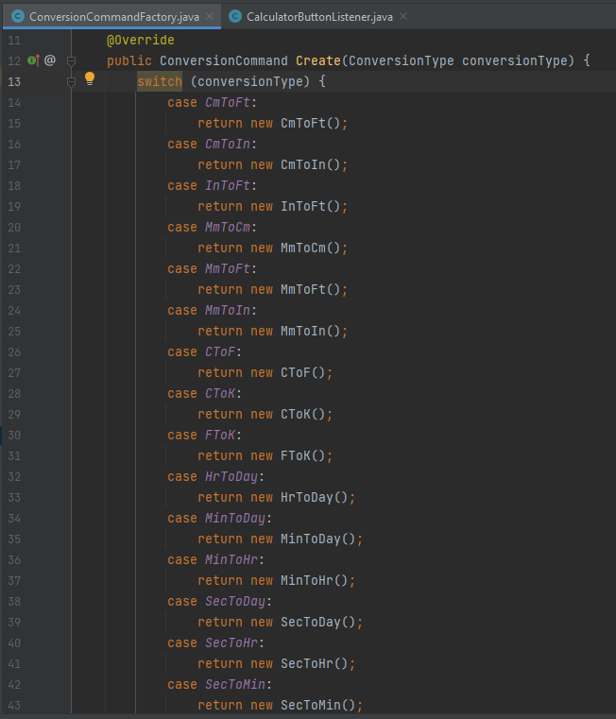
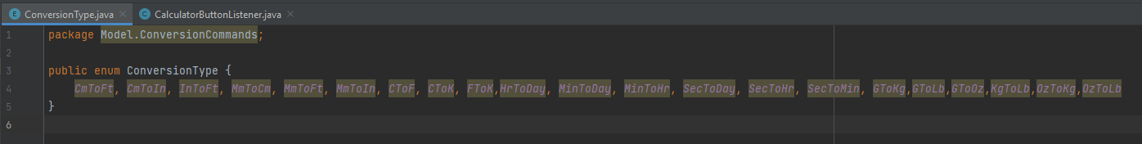

Slide 15
